Slide 1
Instagram
ACCOUNT ANALYTICS
By Akbar Nabiev

Slide 2
LIST OF CONTENTS
1.
INTRODUCTION
2.
INSIGHTS WITH VISUALS
3.
RECOMMENDATIONS

Slide 3
INTRODUCTION
📊 Project: Instagram Performance Analysis
🎯 Goal: Understand engagement trends & improve content strategy
📅 Data: 9 months of Instagram activity (Jan – Sept)
🛠️ Tools Used: MySQL | Power BI | PowerPoint
🌟 Outcome: Actionable insights for better reach, engagement, and growth

Slide 4
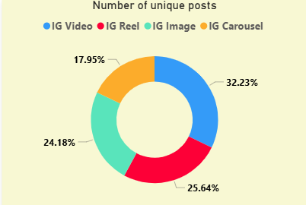
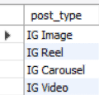
INSIGHTS WITH VISUALS
How many unique post types are found in the 'fact content' table?

Slide 5
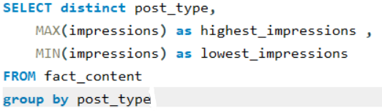
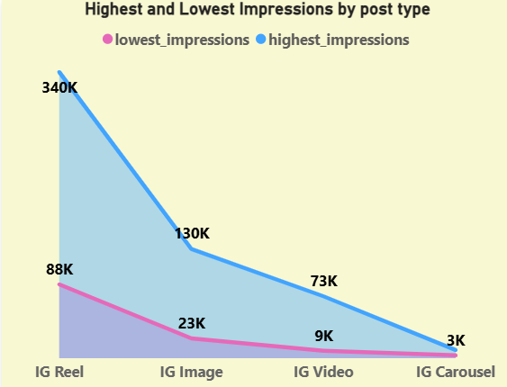
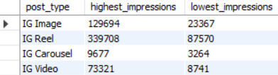
What are the highest and lowest recorded impressions for each post type?

Slide 6

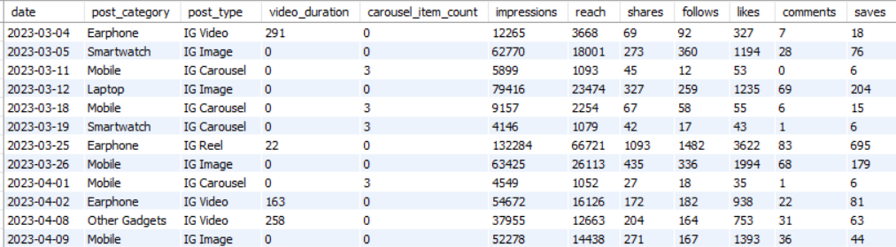
Filter all the posts published on the weekend in March and April and export them to a separate CSV file.

Slide 7
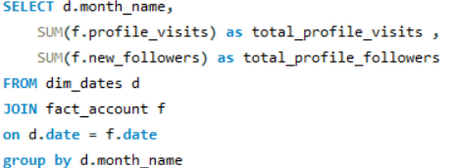
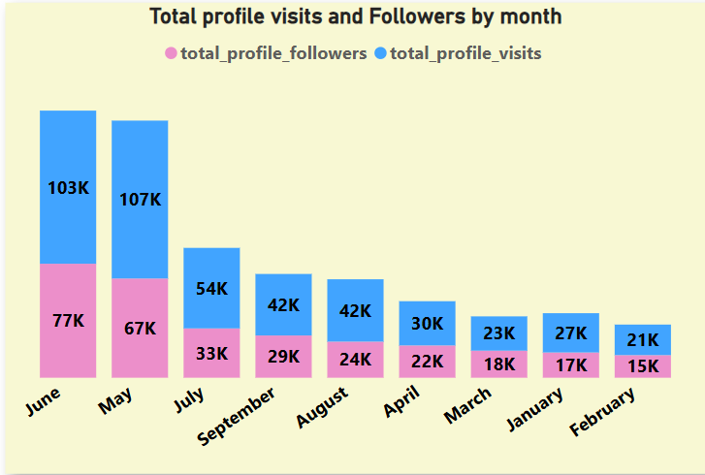
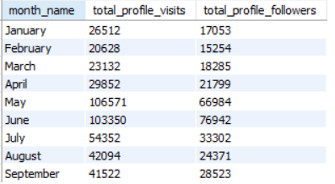
Create a report to get the statistics for the account.
The final output includes the following fields:
• month name
• total_profile_visits
• total_new_followers

Slide 8
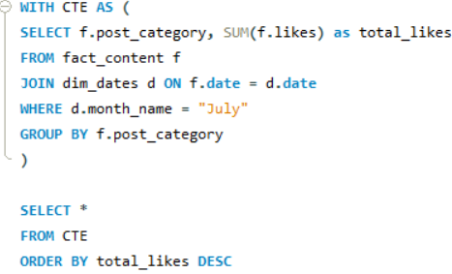
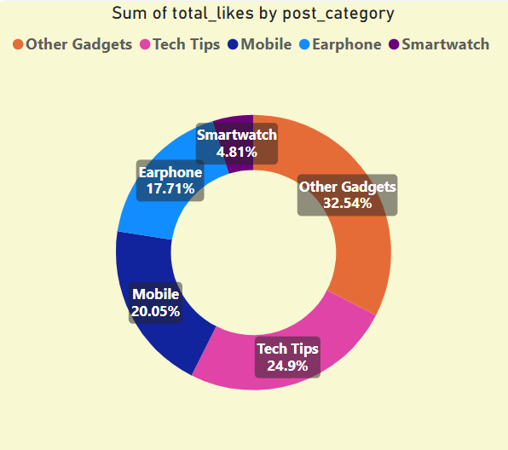
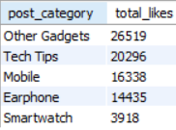
Write a CTE that calculates the total number of 'likes’ for each 'post category' during the month of
'July' and subsequently, arrange the 'post category' values in descending order according to their
total likes.

Slide 9
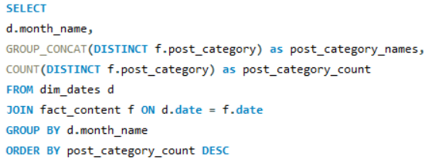
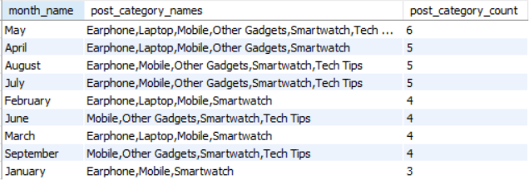
Create a report that displays the unique post_category names alongside their respective counts for each month.
The output should have three columns:
• month name
• post_category_names
• post_category_count

Slide 10
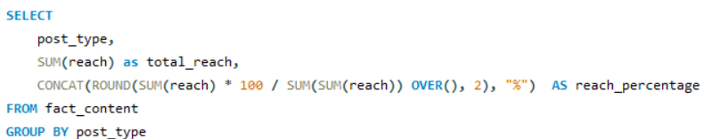
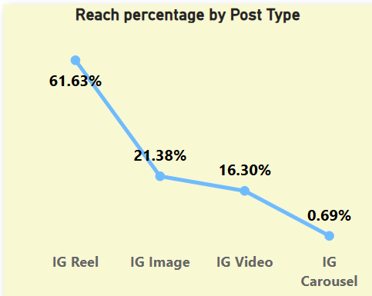
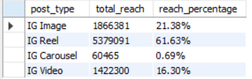
What is the the percentage breakdown of total reach by post type
The final output includes the following fields:
• post type
• total reach
• reach percentage

Slide 11
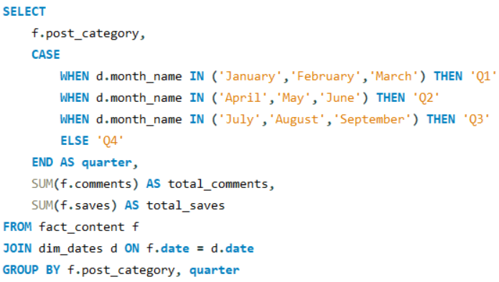
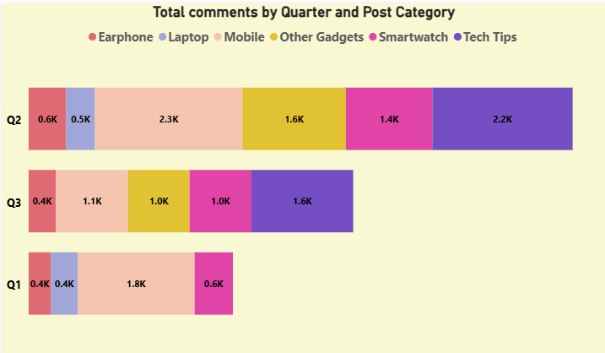
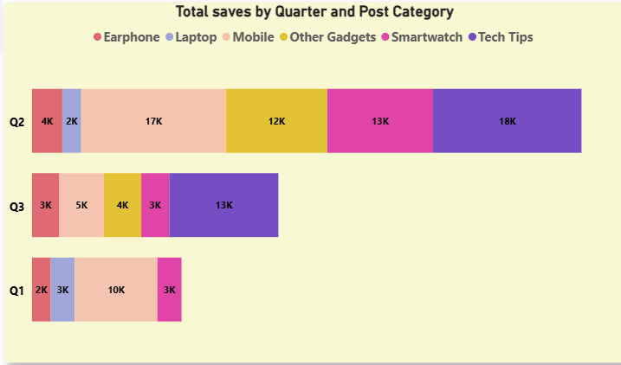
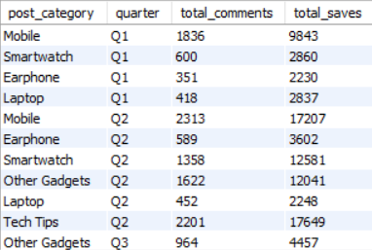
Create a report that includes the quarter, total
comments, and total saves recorded for each post
category

Slide 12
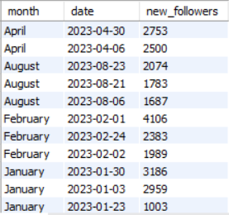
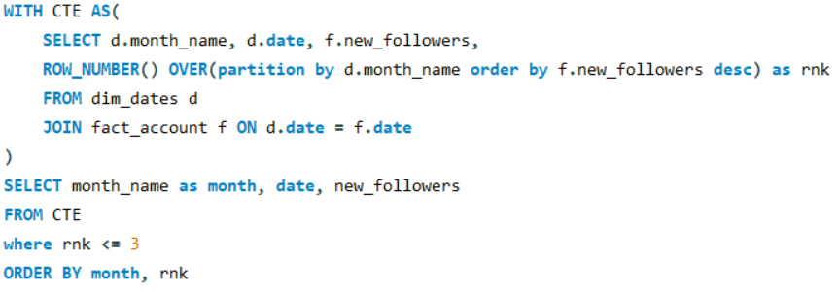
List the top three dates in each month with the highest
number of new followers.

Slide 13
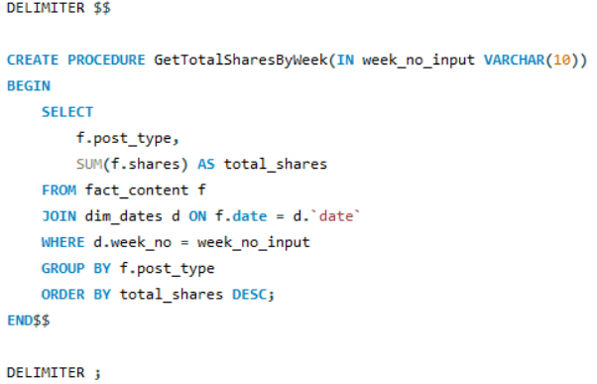


Create a stored procedure that takes the 'Week_no' as input
and generates a report displaying the total shares for each
'Post_type'.

Slide 14

Recommendations
🎥 Focus on Short-Form Content
Post more Reels with trending audio and clear, engaging messages.
Use high-quality visuals to capture audience attention.
📊 Monitor Performance
Track likes, comments, shares, saves, reach, and impressions regularly.
Review results quarterly to align strategy with audience interest.
🧠 Experiment & Improve
Run A/B tests to identify best-performing formats.
Maintain content diversity — mix Reels, carousels, and videos.

Slide 15
THANKS FOR WATCHING!!!

